Slide 1
Emotion Analysis Detection Using NLP
Team Members : Santhi Swarup Yalapalli Vikas Kumar Vejendla

Slide 2
Objective & Problem Statement
To preprocess and analyze tweets for emotion detection.
To compare the performance of LSTM (Deep Learning) with LLM’s(BERT , roBERTa , DistilBERT).
Evaluate results using metrics like accuracy and F1 score.
Objective:
Classify emotions in tweets into predefined categories.
Challenges:
Preprocessing noisy text data.
Handling class imbalances.
Comparing traditional ML with LLM’s(BERT , roBERTa , DistilBERT.

Slide 3
Dataset Overview
Source: Tweets dataset with emotions labeled.
Attributes:
Tweet: The text of the tweet.
Emotion: Associated emotion (e.g., happy, sad).
Dataset Stats:
Total Records: 20,000.
Duplicates Removed: 52.
Null Values: 0.

Slide 4
Data Cleaning and Preprocessing
Text Cleaning Functions:
remove_punctuation()
remove_numbers()
remove_stop_words()
lemmatize_sentence()
Steps Taken:
Remove punctuations, numbers and URLs.
Remove stop words using NLTK.
Lemmatize words for normalization.

Slide 5

Exploratory Data Analysis
Content:
Word Cloud: Frequently occurring words in the tweets.
Distribution of Text Lengths: Histogram visualization.
Key Findings:
Stop words distribution.
Text length analysis informstokenization and padding.

Slide 6
Large Language Models
BERT:
Tokenizer: BertTokenizer
Model: Pre-trained BERT with classification head
Accuracy: Derived from evaluation metrics
Key Characteristics:
Pre-trained on a massive text corpus for bidirectional context understanding.
Fine-tuned on labeled emotion data
DistilBERT:
Tokenizer: DistilBertTokenizer
Model: Lightweight BERT variant with reduced parameters
Accuracy: Comparable to BERT but more efficient

Slide 7
Large Language Models
roBERTa:
Tokenizer: DistilBertTokenizer
Model: Lightweight BERT variant with reduced parameters
Accuracy: Comparable to BERT but more efficient
Key Characteristics:
Trained with a larger batch size and longer sequences.
Enhanced generalization for classification tasks.

Slide 8
LSTM Model Architecture
Model:
Embedding layer with GloVe weights (non-trainable).
LSTM layers: Two layers with 64 units.
Dense output layer with softmax activation for 6 classes.
Training:
Optimizer: Adam
Loss: Categorical Crossentropy
Epochs: 15, Batch Size: 32
Evaluation:
Test Accuracy: LSTM_accuracy, F1-Score: LSTM_f1score.

Slide 9
Evaluation Metrics
Accuracy: Overall model correctness.
F1-Score: Balances precision and recall.

Slide 10
Conclusions
Findings:
Preprocessing techniques significantly enhanced model performance.
Deep learning models outperformed traditional machine learning approaches for emotion classification tasks.
Among the tested models, RoBERTa & BERT achieved the highest accuracy and robustness, followed by DistilBERT.
Lightweight models like DistilBERT offer a good trade-off between speed and performance.

Slide 11
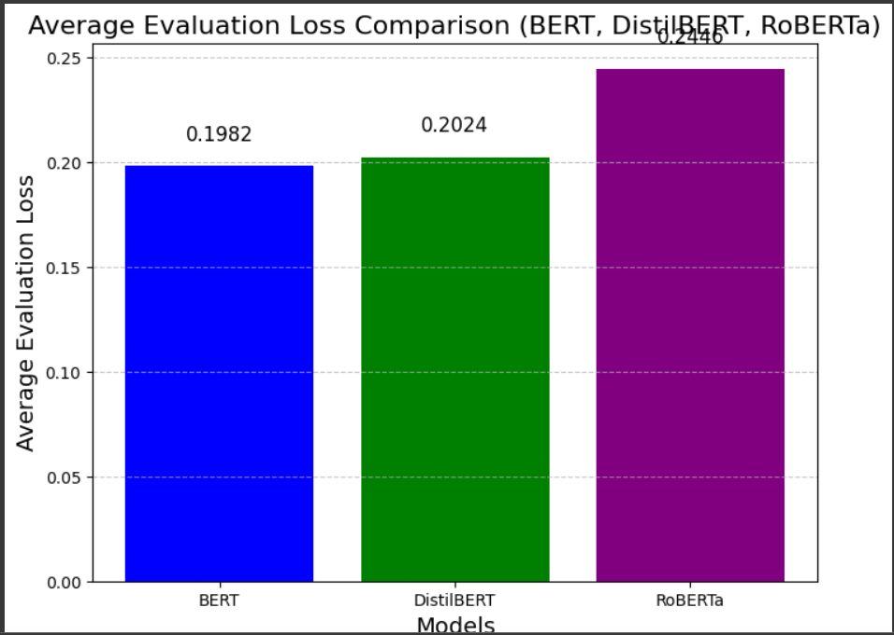
Results
BERT achieved a high accuracy score, demonstrating its robust performance in emotion classification tasks.
DistilBERT offered slightly lower accuracy but provided faster training and lower resource usage, making it efficient for constrained environments.
RoBERTa outperformed other models with the highest accuracy and better evaluation scores due to its optimized training strategies

Slide 12
Future Work
Deploy Real-Time Emotion Detection Systems:
Use lightweight models like DistilBERT for real-time applications, such as chatbots and sentiment analysis tools, ensuring fast and efficient predictions.
Enhance Model Performance Through Pretraining:
Fine-tune BERT and RoBERTa on domain-specific datasets to improve accuracy and generalization for specialized use cases like healthcare or customer service

Slide 13
Thank You

